Slide 1


Introduction to Applied Machine Learning
David Topping
david.topping@manchester.ac.uk
https://github.com/loftytopping
@lanky_manky

Slide 2

Proposed structure of talk
What is it and how can we use it?
Data dependencies
- Quantity
- Features
- Fitting/testing
Neural networks
Todays exercises
Question: ‘How many groups of aerosols have we sampled?’
- Clustering
- Convolutional Neural Networks
- Autoencoders and Network Optimisation
What next?
- Build your tools and software stack
Notes:
The process is becoming circular and the role of domain expertise will shape the future of algorithmic representations, validation and use

Slide 3
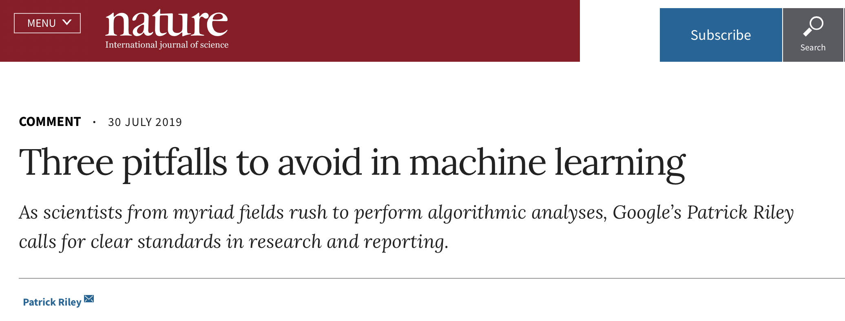
What is it and how can we use it?
‘Machine learning at its most basic is the practice of using algorithms to parse data, learn from it, and then make a determination or prediction about something in the world.’
https://blogs.nvidia.com/blog/2016/07/29/
‘When a new piece of lab equipment arrives, we expect our lab mates to understand its functioning, how to calibrate it, how to detect errors and to know the limits of its capabilities. So, too, with machine learning. There is no magic involved, and the tools must be understood by those using them.’

Slide 4

Long history behind current accessibility
https://news.developer.nvidia.com/on-demand-webinar-deep-learning-demystified/
Notes:
The easiest way to think of their relationship is to visualize them as concentric circles with AI — the idea that came first — the largest, then machine learning — which blossomed later, and finally deep learning — which is driving today’s AI explosion — fitting inside both.

Slide 5
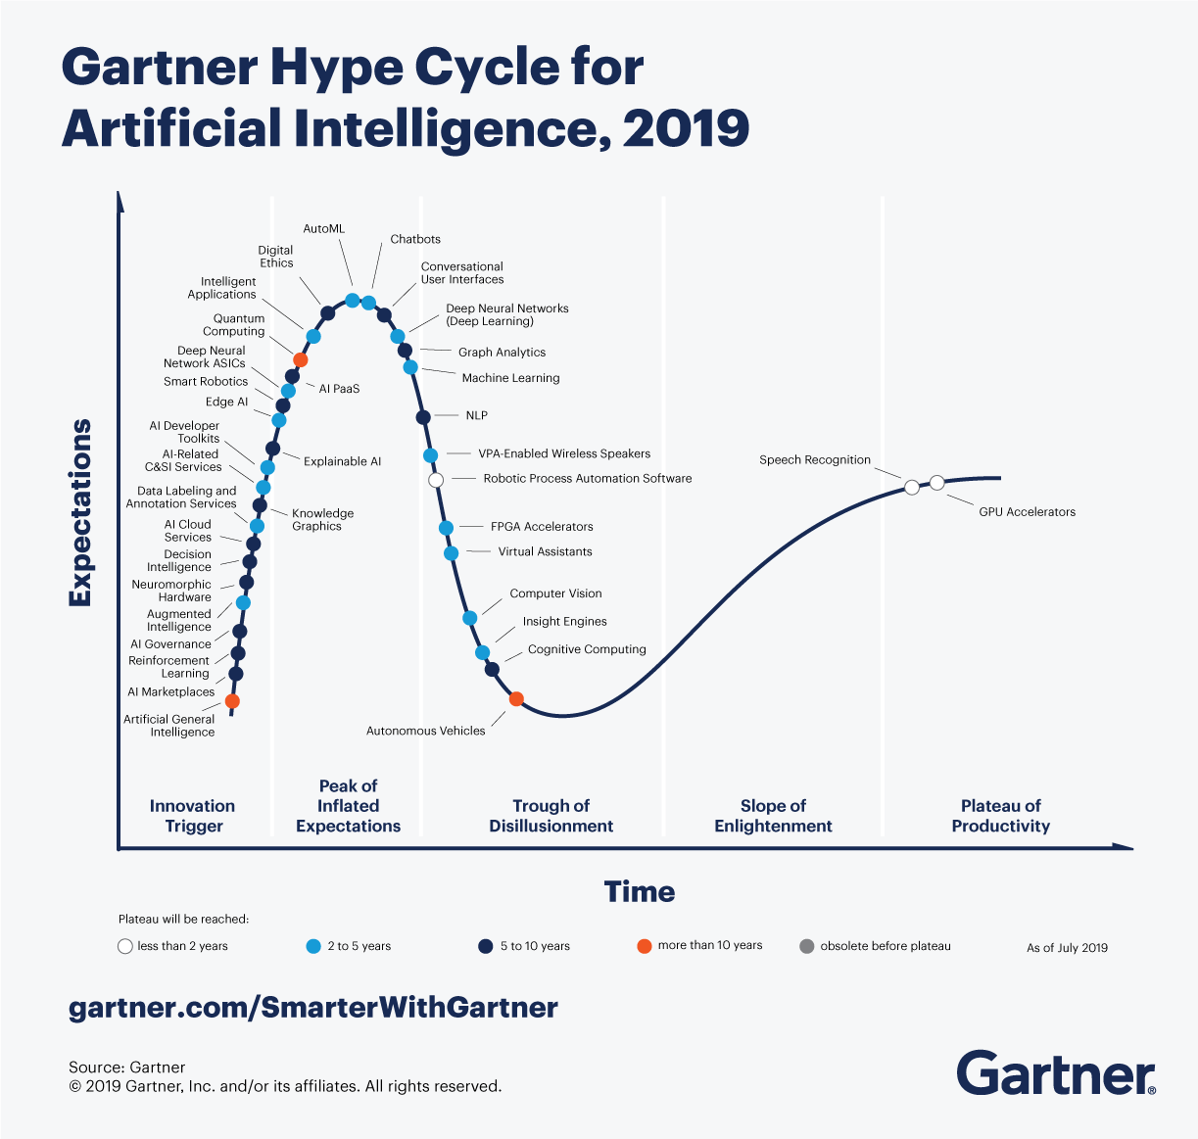
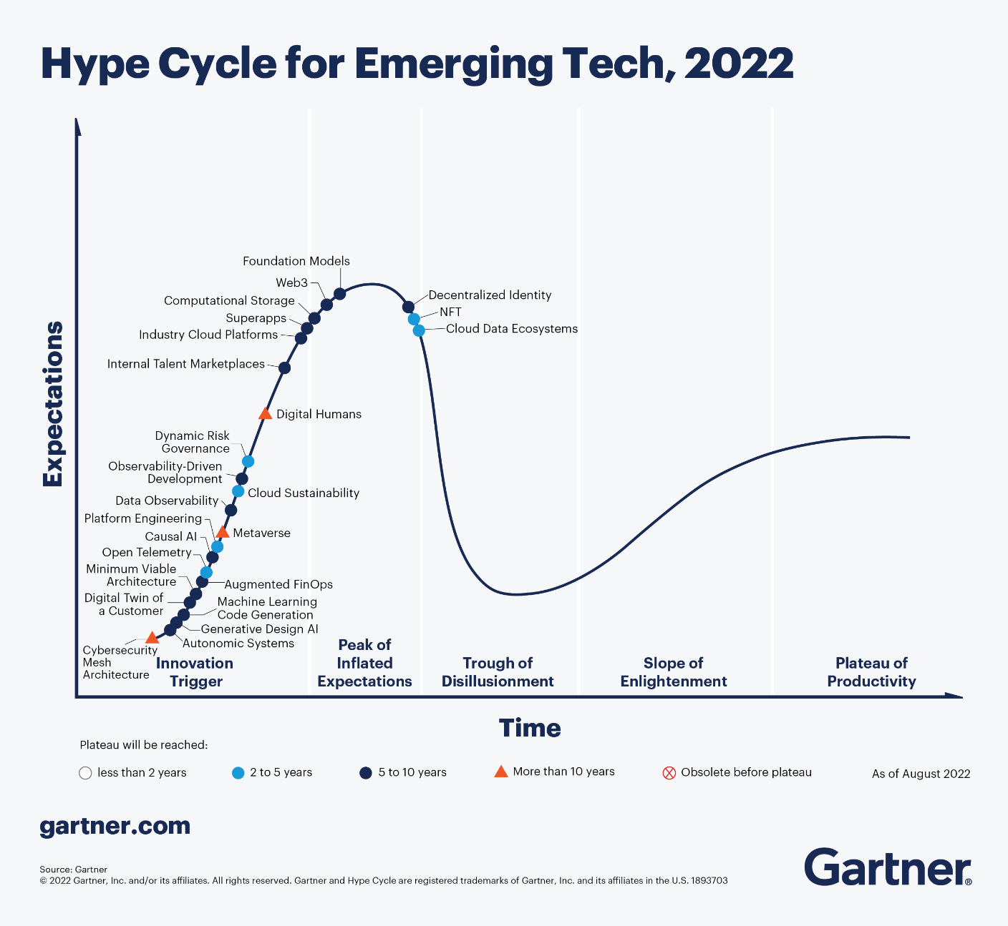
Constantly at/near the peak of expectation?
Emerging technologies for 2022 fit into three main themes: evolving/expanding immersive experiences, accelerated artificial intelligence automation, and optimized technologist delivery.

Slide 6
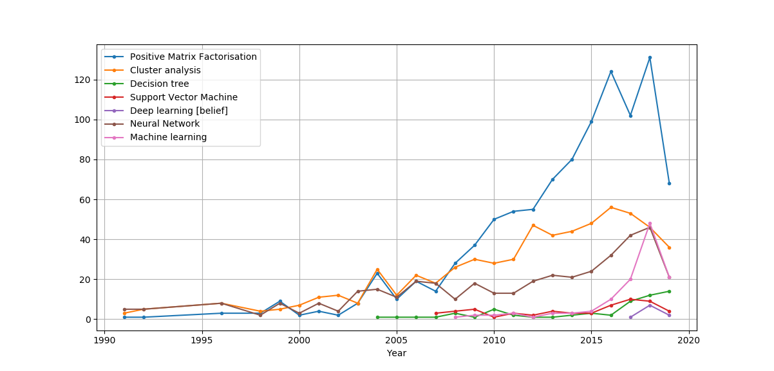
Expected increase in publications.
Models, measurements and impact
Information content
Notes:
Factor analysis is broadly used as a powerful unsupervised machine learning tool for reconstruction of hidden features in recorded mixtures of signals.

Slide 7
What am I solving?
What data do I have?
Do we have any meta-data?
Do we need more data?
Why cant we use existing tools?
What ML methods might help?
Who will use my results?
Machine learning?
Doing Data Science, O'Reilly ISBN: 978-1-449-35865-5. ↑ Forbes-Gil Press-A Very Short History of Data Science-May 2013

Slide 8
IGAC attendee journey
What am I solving?
What data do I have?
Do we have any meta-data?
Do we need more data?
Why cant we use existing tools?
What ML methods might help?
Who will use my results?
Chemical Simulation
Rates, initial concentrations
Some…
Probably?
ODE solvers too slow / cant integrate in regional model
Neural nets or any regression technique
Academics / large-scale modellers
Aerosol classification
Mass spec / scattering.
Some…
Probably?
No standardized method
Time series clustering / computer vision
Academics
High-res pollutant maps
Model output, remote sensing, single sites, land use, met fields
Some…
Probably?
No standardized method / poorly documented
Computer vision / Generative methods
Academics / Policy makers

Slide 9

Most examples of deep learning including classification and time series / sequence analysis
Semi-supervised
Broad areas of machine learning applications
Notes:
Re Unsupervised learning: Because there is no “ground truth” element to the data, it’s difficult to measure the accuracy of an algorithm trained with unsupervised learning. But there are many research areas where labeled data is elusive, or too expensive, to get. In these cases, giving the deep learning model free rein to find patterns of its own can produce high-quality results.

Slide 10
Instrument miniaturisation
Identify gaps in experimental data
Source apportionment
High dimensional dataset visualisation
Rank most important features
Threat / Event detection
Semi-supervised
Source apportionment
Surrogate models / Error functions
Property prediction
Outlier detection
Instrument response function
Mixing state prediction
Model structure
optimisation
Surface minimisation
Evidence, or inferred, in published studies
Optimisation of experiment design
Particulate exposure
reductions
Notes:
We see applications of these broad types of machine learning across aerosol sciences, some common challenges straddle the use of both unsupervised and supervised. Take source apportionment in environmental applications. From a supervised perspective, there are nice papers on using laboratory training data and test scenarios to validate our ability to classify aerosol types, but application in the real-world might demand persistent use of unsupervised methods as we cant guarantee all laboratory derived signatures can represent all possible scenarios. In some cases, such as threat detection, where the signature to be detected represents a tiny fraction of the ambient signal that might be less of an issue but one still needs to factor in performance when aerosols and instruments are exposed to real world conditions…and perhaps more robustness in classification accuracy.
There is often a difference in required time to solution, whether the purpose of the application is to either accelerate prediction over an existing model or information is required to inform a decision making process.
Common challenges are:
- Representatively of training data for all instruments deployed in real time situations.
- Trust in general use over all possible scenarios, true for both regression and classification.
On reinforcement learning, whilst there might not appear to be any studies thus far that dosnt rule out future use. Based on general applications emerging, this could include the following…

Slide 11
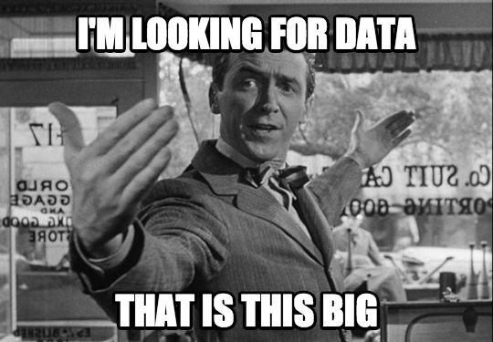
Data dependencies

Slide 12
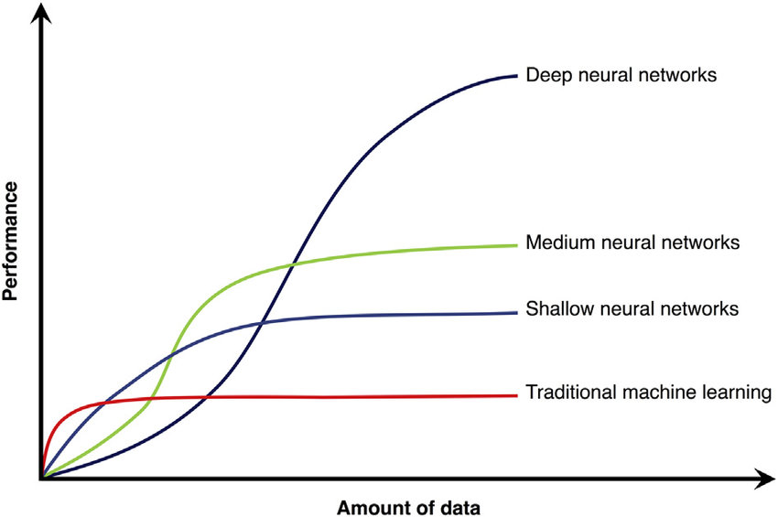
How much data do I need?
‘…It has been well established both across industry and academia that for a given problem, with large enough data, very different algorithms perform virtually the same…’
More data enables us to try and minimise both bias and variance
What if the cost of accessing new data is simply too expensive or not easily resourced?
What if I don’t have access to a massive GPU or lots of memory?
Notes:
Most of the There are ongoing debates about the value of small versus large datasets, and some general rules of thumb do still apply…both in terms of predictive power and
We can be responsive to this now and start to test different performances. A key is to

Slide 13
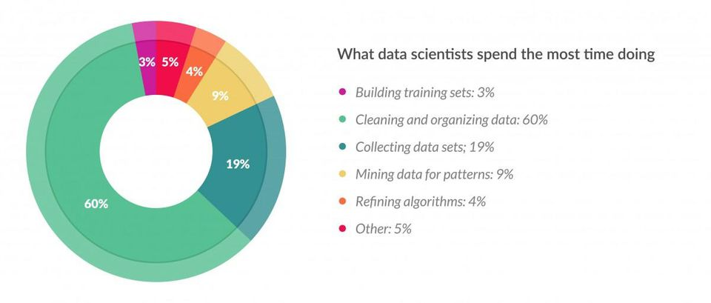
Data preparation takes up >90% of the machine learning pipeline
‘76% of data scientists view data preparation as the least enjoyable part of their work’
https://www.forbes.com/sites/gilpress/2016/03/23
Domain expertise and calibration standards essential. Your jobs are safe!

Slide 14
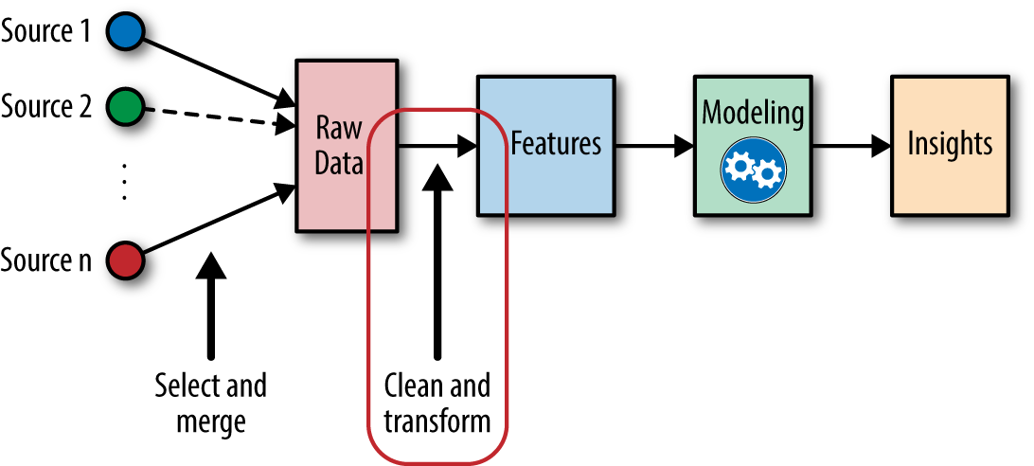
Features
Feature engineering
Using domain knowledge of the data to create features that make machine learning algorithms work.
What do I need to predict PM2.5 ahead of time?
I have access to:
- Time series from one site
- Basic met data [pressure, temp, RH]
I could get access to:
- Boundary layer height
- NO2, O3,..
- land-use
Coming up with features is difficult, time-consuming, requires expert knowledge. "Applied machine learning" is basically feature engineering. — Andrew Ng, Stanford University
Notes:
That domain knowledge best encapsulates predictions at a range of scales and complexities

Slide 15
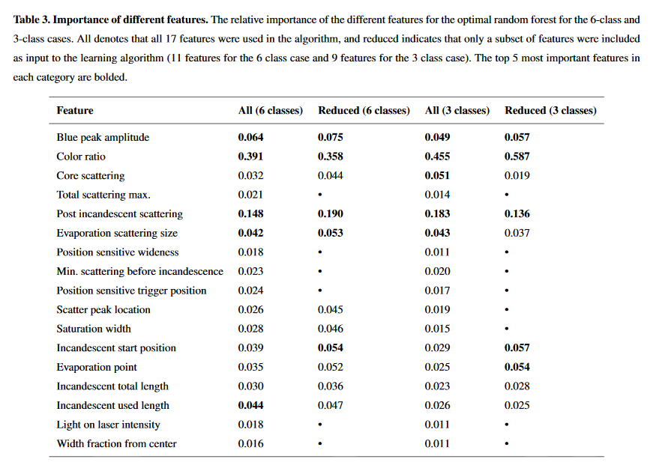
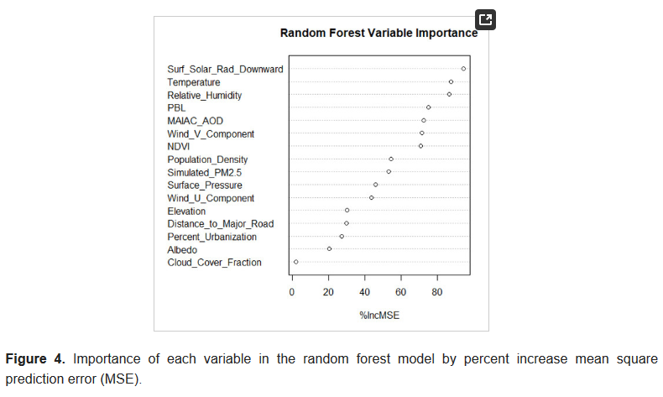
Using Interpretable algorithms
Is the algorithm extracting relationships that make sense?
Bryan N. Vu et al. Developing an Advanced PM2.5 Exposure Model in Lima, Peru. Remote Sens. 2019, 11(6), 641; https://doi.org/10.3390/rs11060641
Lamb, K. D.: Classification of iron oxide aerosols by a single particle soot photometer using supervised machine learning, Atmos. Meas. Tech. Discuss., https://doi.org/10.5194/amt-2019-106, in review, 2019.
The easiest way to achieve interpretability is to use only a subset of algorithms that create interpretable models..[…]. – Christoph Molnar, https://christophm.github.io/interpretable-ml-book/
Notes:
In the rush for applying large neural networks, quite often the benefit of simpler methods can be overlooked – especially the ability to interpret the relationships learned during the fitting or application process. Extraction of key features deemed important to achieve a particular goal is an important step in ensuring you are not getting the right answer for the wrong reasons. Of course one might argue that if relationships are known aprior then a simpler heuristic can be derived, but this still dosnt mean the quantitative framework can easily be constructed which in this case would be dealt with the underlying algorithms.

Slide 16
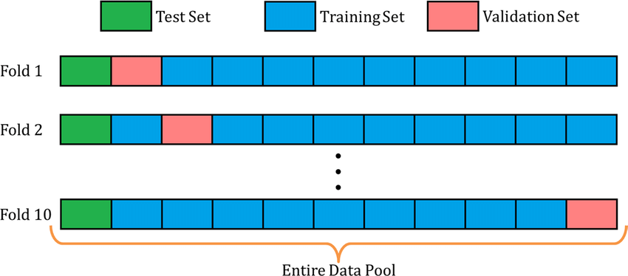
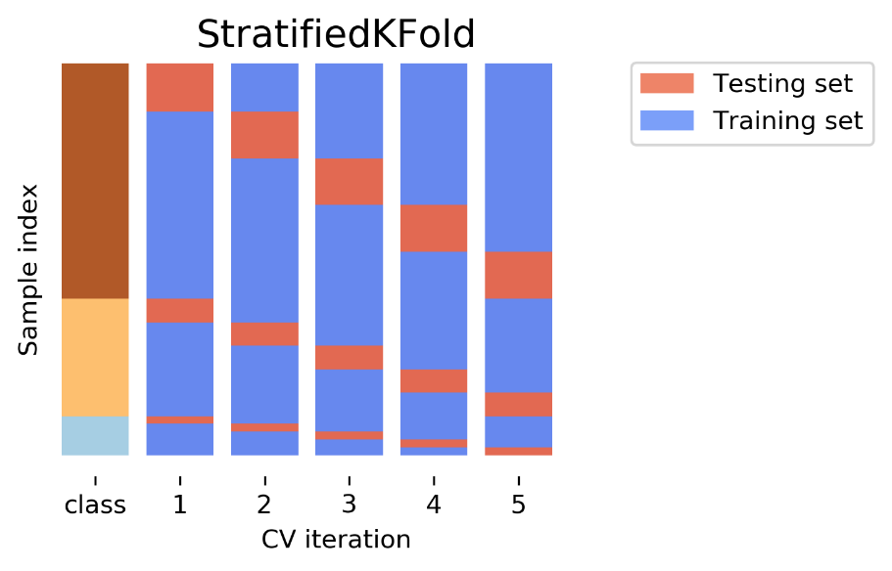
Fitting – testing
How do I stop my model overfitting?
I want to evaluate how good my model is on data it hasn’t seen…
There are functions in popular ML package's that enable the user to specify
- How many folds
- test:train:validation split
- level of stratification
My data has imbalanced classes……
I want to predict ahead of time…
Notes:
Combining the use of both supervised and un supervised learning can reveal limitations in both the training dataset but also help infer limitations of the resolving power of the instrument in question. In this case where manual interpretation of results of basic cluster analysis might lead to assigning particulate types within broad bio-aerosol classes….automatic classification of those types, according the laboratory training data, reveals sensitivities to data preparation standards but also mismatches with the aforementioned cluster analysis assignment.
This will change with increases in the resolving power of the instruments

Slide 17
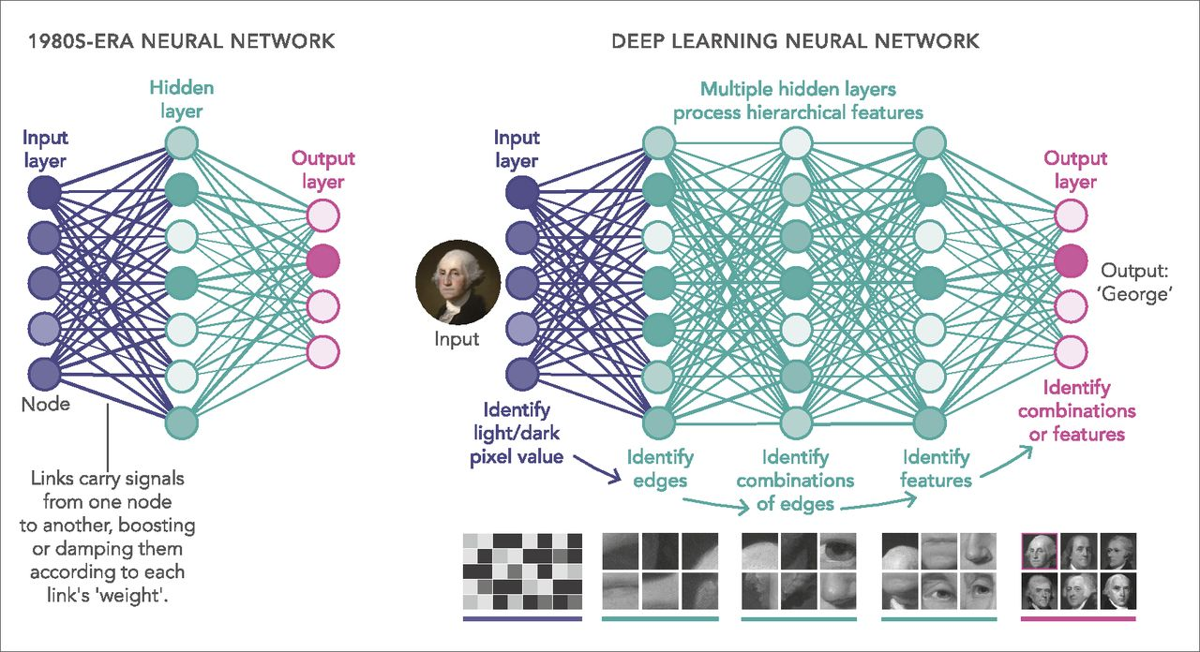
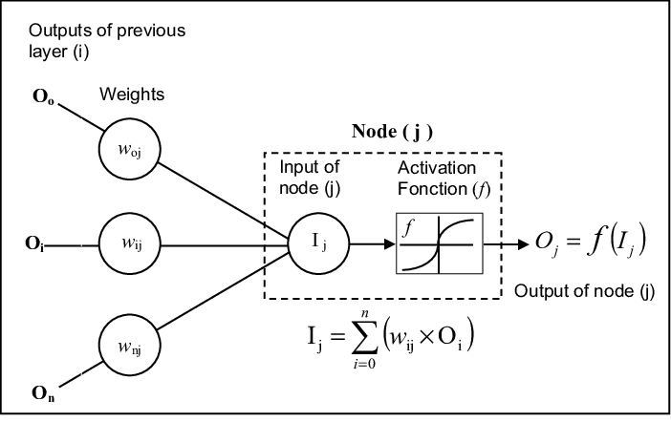

Neural networks
name and structure are inspired by the human brain, mimicking the way that biological neurons signal to one another.

Slide 18
Neural networks
As you build your network you need to think/ask
How many layers do I need?
How many nodes?
Are all nodes connected?
What is the most appropriate activation function?
How do I define performance?
- there are multiple loss functions [mean squared error, binary cross entropy…]
What happens when I modify my input data? Does that improve model performance?
There are ways to do all of the above. Best way is to start ‘something’
- I will provide code on a toy example
18

Slide 19
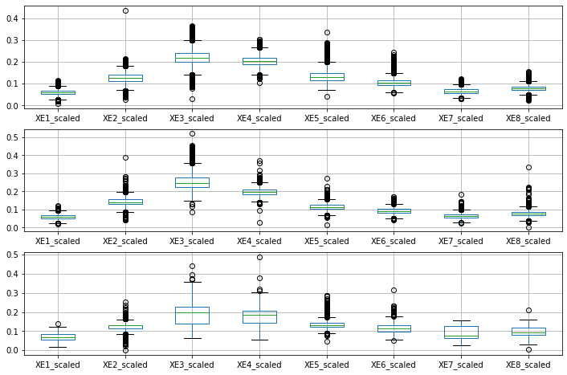
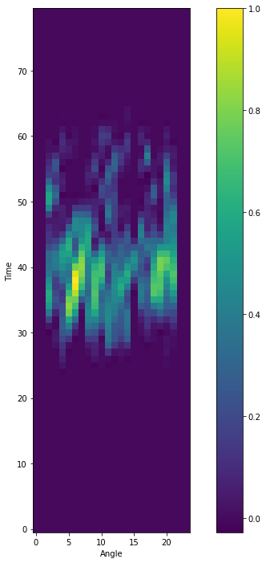
Todays exercises
Fluorescence signature
Scattering image
instrument
How many different types of particles do we detect?
What are they?
Are they important?
Why do the concentrations change?

Slide 20
Todays exercises
Fluorescence signature
Scattering image
instrument
Cluster analysis
Unsupervised learning
Pre-processing
Autoencoders
Pre-processing
K-means, Hierarchical Agglomerative Clustering…

Slide 21

Our workflow….
Notebook 1
Fluorescence signature
Pre-processing
Cluster analysis
Unsupervised learning
Scattering image
Pre-processing
Convolutional, LSTM, Autoencoders
Notebook 2
Optimising network design
Notebook 3
21

Slide 22
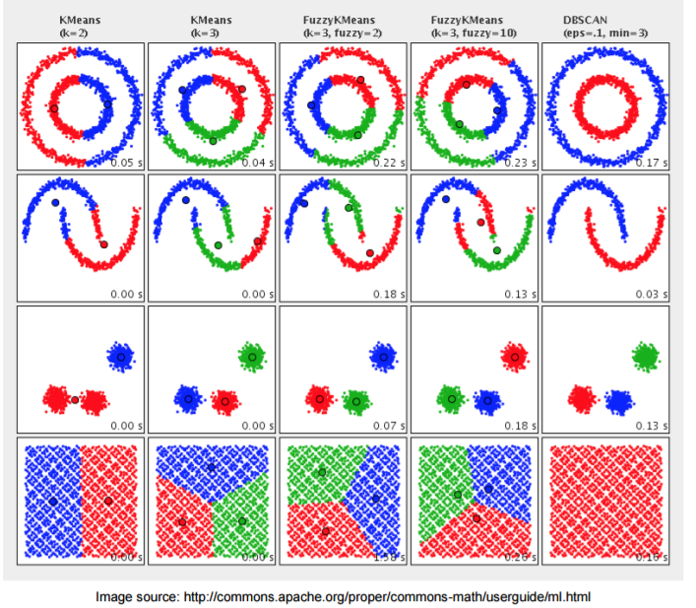
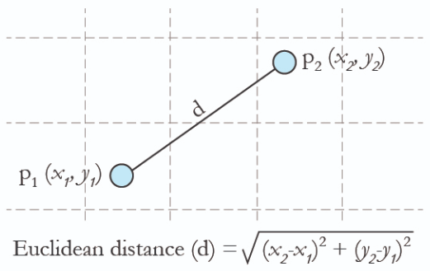
Cluster Analysis
Group ‘similar’ members.
How do we set the number of groups?
How do we define a similarity ‘distance’?

Slide 23

Convolutional Neural Networks [CNNs]
The standard VGG-16 network architecture

Slide 24
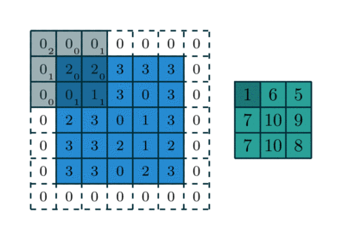
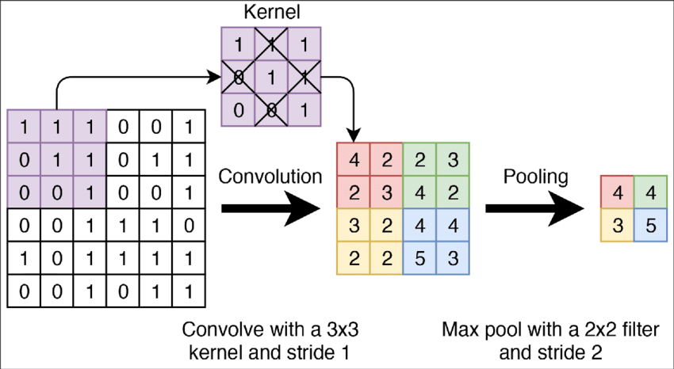
convolutional layer is a stack of feature maps where we have one feature map for each filter.
large datasets with many different object categories will require a large number of filters; each responsible for finding a pattern in the image.
More filters mean a bigger stack which means that the dimensionality of our convolutional layers can get quite large.

Slide 25
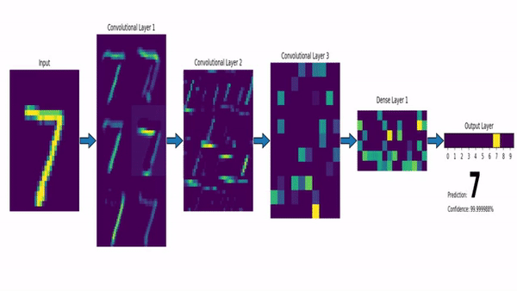

Slide 26
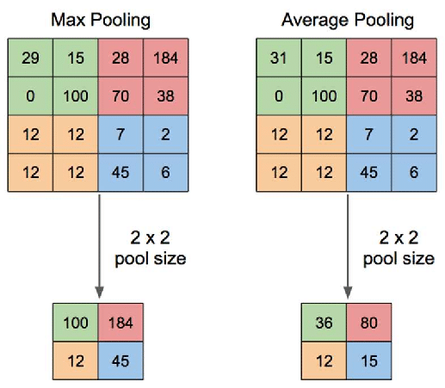

Higher dimensionality means we'll need to use more parameters which can lead to overfitting
We need a method for reducing this dimensionality. This is the role of pooling layers.

Slide 27
Autoencoders – generating a space to cluster
High number of dimensions
problem for standard clustering techniques
1) Dimension reduction techniques + standard clustering shown to be more stable
What are distinct clusters?
What about outliers?
Data cleaning / pre-processing
Original Mass Spectra
Original Mass Spectra
Latent vector
la
Semi-supervised learning
Unsupervised learning
Labelled spectra
Unlabeled sample reconstruction
Labelled sample reconstruction

Slide 28
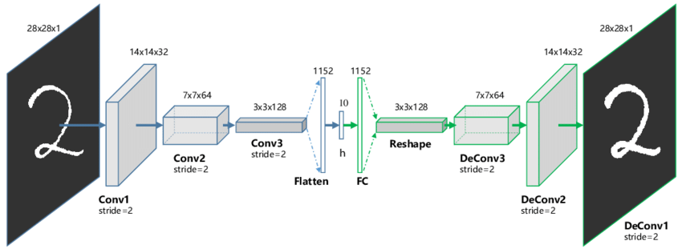
CNNs - Autoencoders
What does the latent space represent??
Id like us to look at this in Python code

Slide 29
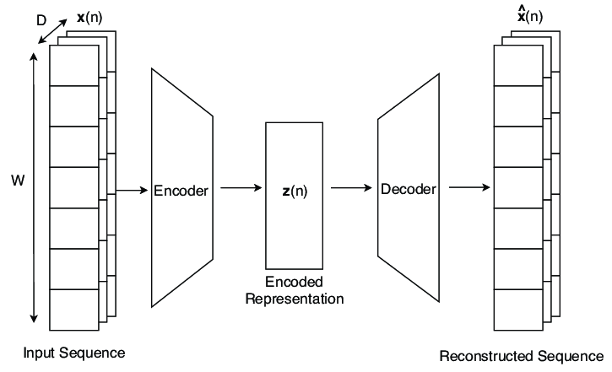
LSTM - Autoencoders
time…
time…
What does the latent space represent??
Id like us to look at this in Python code

Slide 30
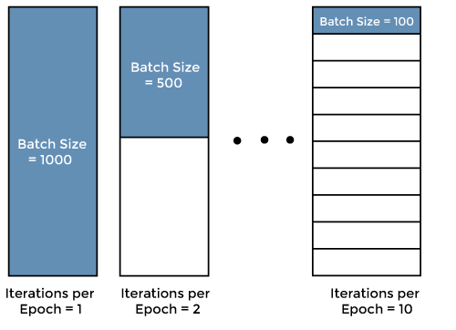
Fitting – testing
How do we fit an entire neural network
I want to evaluate how good my model is on data it hasn’t seen…
Epoch – one sweep over the entire dataset
Batch size – how many samples in a ubset
Iterations – number of times weights are updated
Notes:
Combining the use of both supervised and un supervised learning can reveal limitations in both the training dataset but also help infer limitations of the resolving power of the instrument in question. In this case where manual interpretation of results of basic cluster analysis might lead to assigning particulate types within broad bio-aerosol classes….automatic classification of those types, according the laboratory training data, reveals sensitivities to data preparation standards but also mismatches with the aforementioned cluster analysis assignment.
This will change with increases in the resolving power of the instruments

Slide 31
What next?
Build your tools and software stack [Python]
Data
Pandas: https://pandas.pydata.org
Scikit learn: https://scikit-learn.org/stable/
Dask: https://www.dask.org
Digital CV
Github: https://github.com
Zenodo:https://zenodo.org
Cloud services
Google Colab: https://colab.research.google.com
Binder: https://binderhub.readthedocs.io/en/latest/
Machine learning
Scikit learn:https://scikit-learn.org/stable/
Keras:https://keras.io
PyTorch:https://pytorch.org

Slide 32
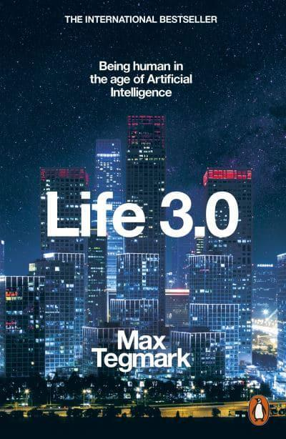

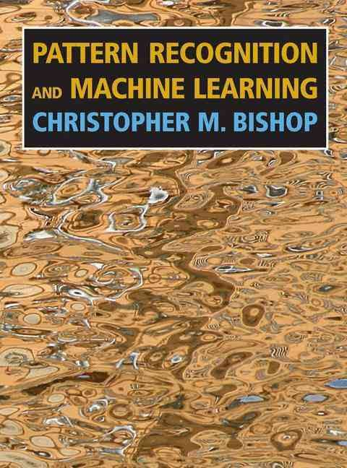


Embrace the culture of AI
Machine Learning Glossay
https://developers.google.com/machine-learning/glossary
32
32

Slide 33
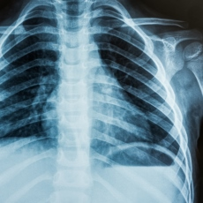

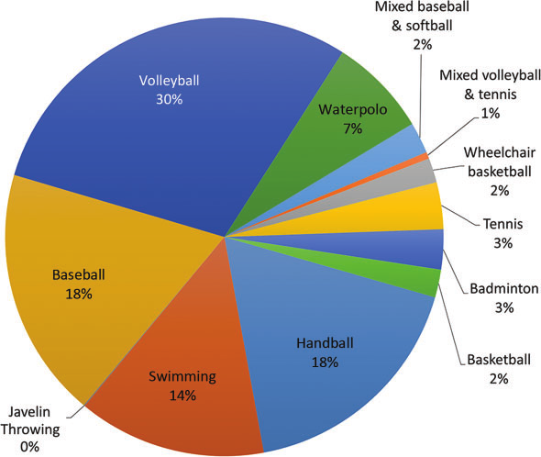
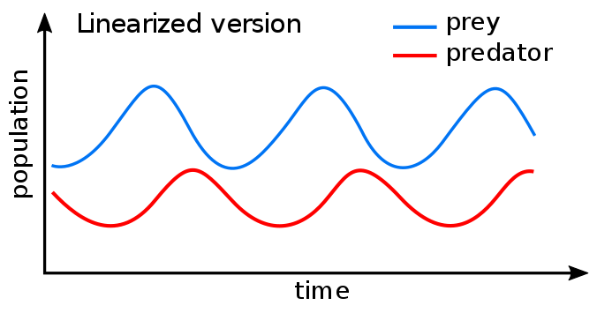

e.g. Pharmacokinetics/Pharmacodynamics
What does the future hold?
Do ‘pure’ ML representations have a limited shelf-life?
Patient Data (e.g. X-ray scans)
Simulation parameters
(e.g. drug half-life)
Treatment Outcome
Neural Network
ODE Solver
β = 0.56
Slide c.o Mike Innes, Julia Computing [mike@juliacomputing.com]
Backpropagation
The next step will be a hybrid modelling approach, coupling physical process models with the versatility of data-driven machine learning. Deep learning and process understanding for data-driven Earth system science. Markus Reichstein et al. Nature 566, pages 195–204 (2019)
Notes:
Also nature article on the

Slide 34
Left with important questions around community ethos
Do we value the ‘slow and hard’ stuff as we should?
Databases, calibration standards and meta-data.
Renewed vigor in combining mechanistic and empirical model developments.
Training is key. Heterogenous issue. More than .fit() .predict(). Can we publish negative results? What platforms will we be using in 5+ years?
Is there a role of ‘big tech companies’?
Open source a great step – documentation needs to follow!!!
We might benefit from a community repository of relevant examples with relevant data
There are challenges, but there are many exciting opportunities!
Notes:
Nature article: Disciplines need to develop clear standards for how to perform and report on machine learning in their areas.
Education of scientists in machine learning needs to include these broader issues. We often teach the algorithms and tools, but students need to learn more about how to apply their algorithms and question them appropriately.
On standards:
The appropriate controls, soundness checks and error measurements will vary from field to field, and these need to be spelt out clearly so that researchers, reviewers and editors can encourage good behaviour.

